Slide 1
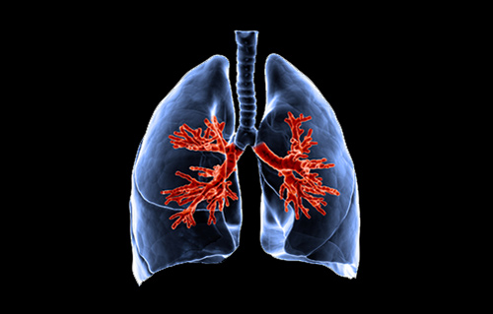
Sputum Clearance
Better Breathing
Physiotherapist
Notes:
<number>

Slide 2
Outline
Function of secretions
Importance of clearing secretions
Clearance techniques
Notes:
<number>

Slide 3
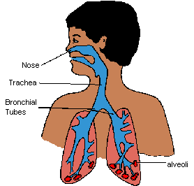
Secretions
Phlegm, mucus, spit, sputum
  Normal fluid produced by the body
  Clear, creamy, yellow
  Green or brown may indicate infection
Role
  Transport foreign objects out of the lungs
Damage to airways can cause difficulty clearing secretions
Notes:
<number>

Slide 4
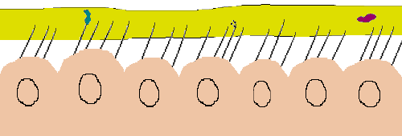
Movement of Cilia

Slide 5
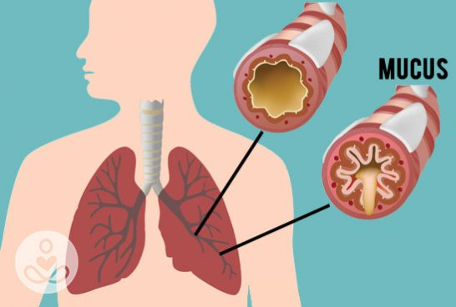
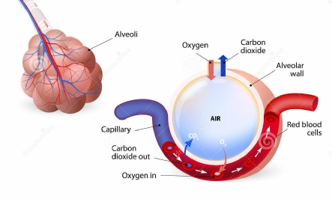
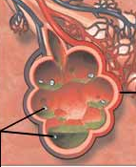
Importance of clearing secretions
Airway hygiene
  Environment for infection
Increases gas exchange
  - Lack of oxygen
Makes breathing easier
  - Feeling short of breath
Chronic cough
  Social impact
  Stress incontinence
Notes:
<number>

Slide 6
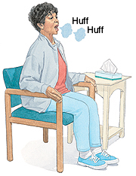

Clearance techniques
Exercise
Deep breaths
Cough/ huff
Steam
Hydration
Inhalers
Gravity
Notes:
<number>

Slide 7
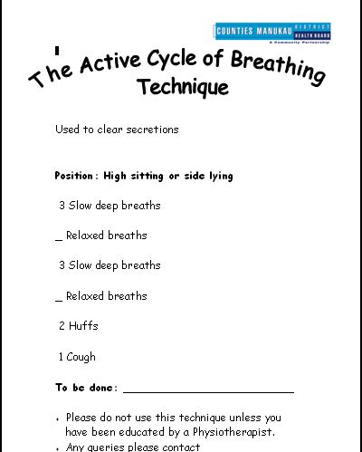
Notes:
<number>

Slide 8
Summary
Function of secretions
Importance of clearing secretions
Clearance techniques
Notes:
<number>

